Slide 1
Information of OOPS concepts
-NIKITA MAHANGADE

Slide 2
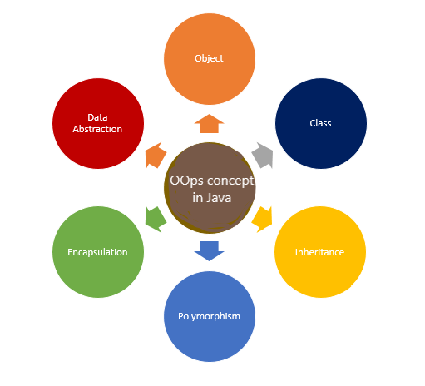
OOPS concepts
OOPS concepts are as follows:
Class
Object
Pillars of OOPs
Abstraction
Encapsulation
Inheritance
Polymorphism
Compile-time polymorphism
Runtime polymorphism

Slide 3
Class
A Class is a user-defined blueprint or prototype from which objects are created. It represents the set of properties or methods that are common to all objects of one type.
Using classes, we can create multiple objects with the same behavior instead of writing their code multiple times. This includes classes for objects occurring more than once in your code.

Slide 4
Object
An object is a basic unit of Object-Oriented Programming that represents real-life entities.
object is an instance of a class that encapsulates data and functionality including that data
An object is a component of a program that knows how to perform certain actions and how to interact with other elements of the program
A simple example of an object would be a person

Slide 5
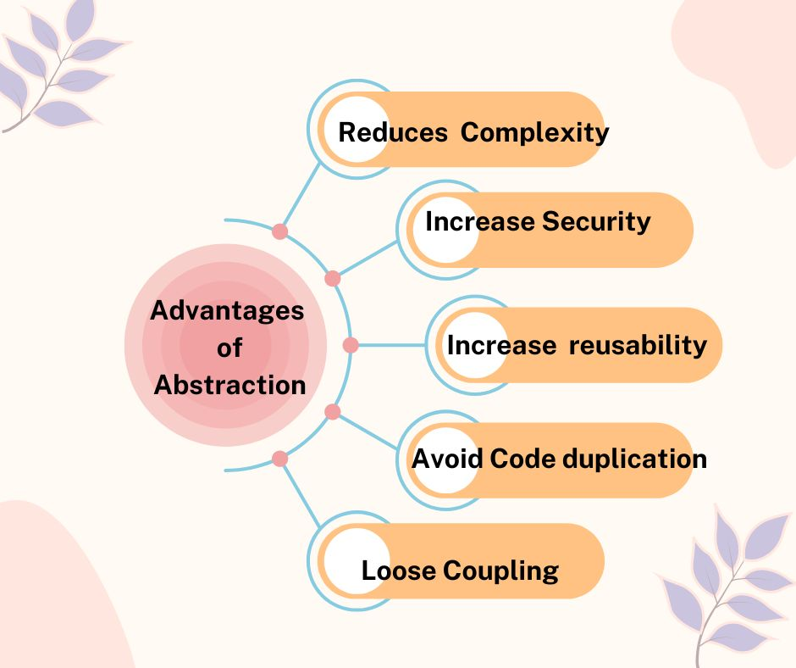
Abstraction
Data Abstraction is the property by virtue of which only the essential details are displayed to the user. The trivial or non-essential units are not displayed to the user.
Data Abstraction may also be defined as the process of identifying only the required characteristics of an object, ignoring the irrelevant details.

Slide 6
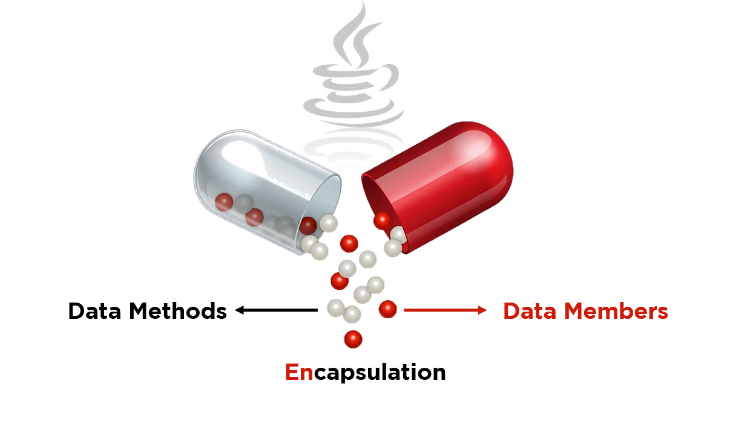
Encapsulation
Encapsulation the variables or the data in a class is hidden from any other class and can be accessed only through any member function of the class in which they are declared.
Encapsulation which is similar to data-hiding . So, the terms “encapsulation” and “data-hiding” are used interchangeably.
Encapsulation can be achieved by declaring all the variables in a class as private and writing public methods in the class to set and get the values of the variables

Slide 7
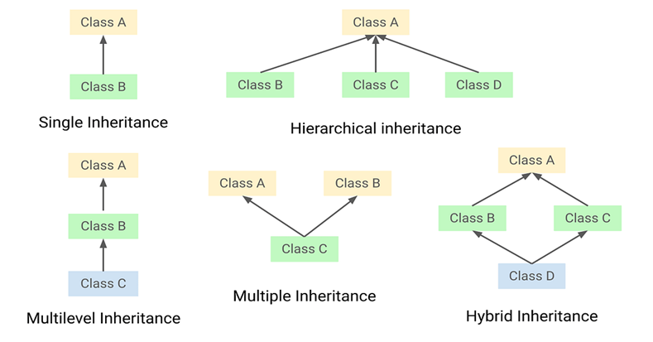
Inheritance
Inheritance is an important pillar of OOP. It is the mechanism in Java by which one class is allowed to inherit the features of another class.

Slide 8
Polymorphism
Polymorphism is one of the core concepts in OOP languages and describes the concept of using different classes with the same interface.
Polymorphism allows to define one interface and have multiple implementations.
Java supports two kinds of polymorphism..
Overloading
Overriding

Slide 9
Advantages
OOP promotes code reusability: By using objects and classes, you can create reusable components, leading to less duplication and more efficient development.
OOP enhances code organization: It provides a clear and logical structure, making the code easier to understand, maintain, and debug.
OOP supports the DRY (Don’t Repeat Yourself) principle: This principle encourages minimizing code repetition, leading to cleaner, more maintainable code. Common functionalities are placed in a single location and reused, reducing redundancy.
OOP enables faster development: By reusing existing code and creating modular components, OOP allows for quicker and more efficient application development.

Slide 10
Conclusion
The Object Oriented Programming (OOPs) concept in Java is a powerful way to organize and write code. It uses key ideas like classes, objects, inheritance, polymorphism, encapsulation, and abstraction to create flexible and reusable code.
By using the Java OOPs concept, programmers can build complex applications more efficiently, making the code easier to manage, understand, and modify.

Slide 11
THANK YOU…

